Slide 1

APPLICATION OF TURING MACHINE IN ARTIFICIAL INTELLIGENCE
Made by:-
16010421119 - Aarya Tiwari
16010421120 - Sumit Tiwari
16010421121 - Virinchi Tonge

Slide 2
01
What is Turing Machine?
Points we will cover in this presentation
02
How does a Turing Machine work?
03
Some Applications of Turing Machine
In Artificial Intelligence
04
Why Turing Machine?

Slide 3
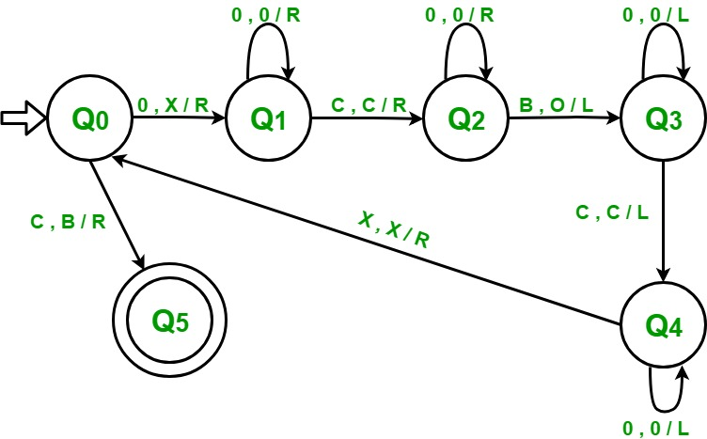
Turing Machine
A Turing Machine is a theoretical computing machine invented by Alan Turing in 1936. It serves as an idealized model for mathematical calculation and is used to investigate the extent and limitations of what can be computed
A Turing Machine consists of a tape divided into cells, a head that can read and write symbols on the tape, and a set of instructions that determine the machine's behavior. The tape is infinite in length and divided into discrete cells, each capable of holding a symbol from a finite alphabet.
The head can move left or right along the tape and read or write symbols on the current cell. The instructions specify how the machine should transition between different states based on the current symbol read and the current state

Slide 4
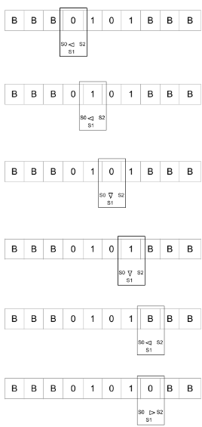
Working Of Turing Machine
A Turing Machine performs computation by repeatedly executing a sequence of steps. At each step, the machine reads the symbol on the current cell, consults the set of instructions to determine the next state and symbol to write, moves the head left or right, and repeats the process.
The machine can change its internal state, modify the symbol on the tape, and move the head in response to the current symbol and state

Slide 5
Applications of Turing Machine
Natural Language Processing
turing machine can be used to design and analyze algorithms for speech recognition, text classification, sentiment analysis, and machine translation.
Computational Complexity
Logic and Reasoning
Determining time complexity and space complexity of Machine Learning Algorithms
Turing Machines provide a framework for formal logic and reasoning. They are used to analyze and prove theorems in logic, which forms the basis for AI systems that perform automated reasoning and logic-based decision making
Machine Learning
Turing Machine helps in understanding the theoretical limits of what can and cannot be learned.
For example, the concept of "PAC-learnability" is based on the idea of a Turing Machine and is widely used in machine learning theory.
Automated Planning
BPlanning is an important component of AI systems, and Turing Machines help in designing algorithms that can generate optimal plans based on given constraints

Slide 6
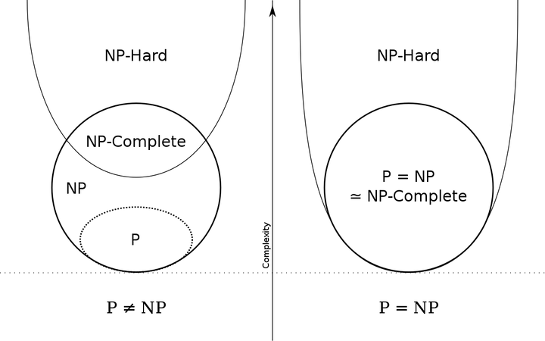
Computational Complexity
While they are not directly used in the practical implementation of AI and machine learning algorithms, they play an essential role in the theoretical analysis and understanding of these algorithms.
Turing machines are often used to analyze the computational complexity of AI and ML algorithms. Complexity theory helps us understand how algorithms scale with input size, which is crucial for assessing their efficiency and practicality. By representing algorithms as Turing machines, researchers can categorize them into complexity classes (e.g., P, NP, NP-hard) and determine their time and space complexity
Turing machines are particularly useful for analyzing decision problems and proving their computational properties. For example, researchers might use Turing machines to show that a problem is NP-hard, implying that there is likely no efficient algorithm to solve it in all cases

Slide 7
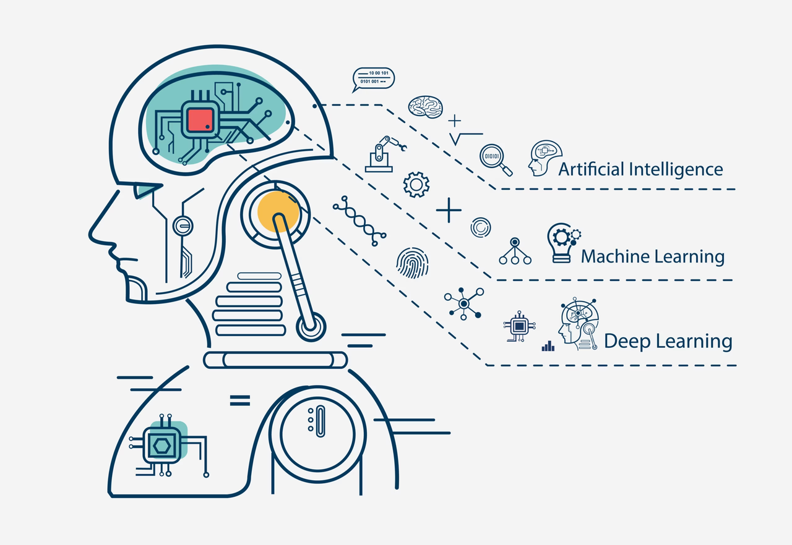
Machine Learning
In some cases, reinforcement learning algorithms involve state machines or Markov decision processes, which have theoretical ties to automata theory. While the practical implementation may not involve Turing machines, the theoretical foundations can be traced back to these concepts.
Theoretical aspects of machine learning, such as the analysis of overfitting, bias-variance trade-off, and generalization, are influenced by mathematical concepts rooted in the theory of computation.

Slide 8
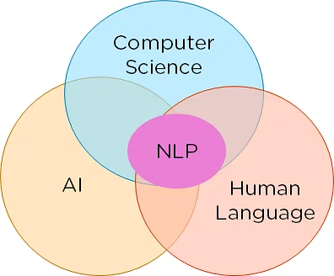
Natural Language Processing
NLP often deals with the manipulation and understanding of natural languages, which can be described using formal languages.
Formal language theory, closely related to automata theory and Turing machines, provides the theoretical framework for describing the grammatical rules and structures of natural languages.
Context-free grammars, regular expressions, and pushdown automata are used to model language syntax, which is fundamental in parsing and generating natural language text.

Slide 9
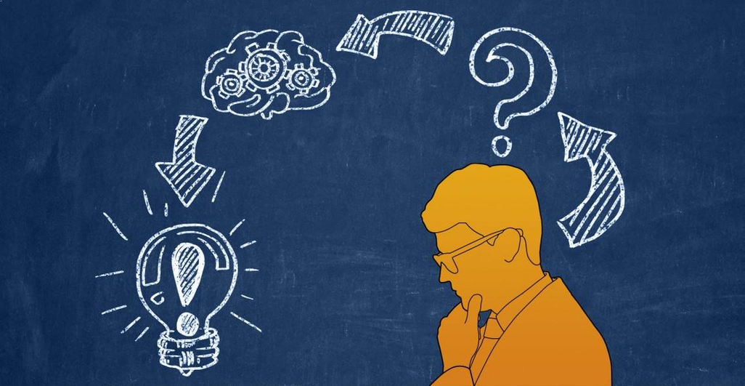
Logic and Reasoning
Turing Machines can be used to prove some of the following theories
Computability Theory: Turing machines are a fundamental concept in computability theory, which is concerned with what can and cannot be computed algorithmically.
Proof Theory: In mathematical logic, Turing machines can be used to model and reason about the concept of effective calculability, which is closely related to proofs and the idea of a constructive proof.
Non-Classical Logics: These logics extend classical logic to reason about specific types of knowledge, time, or inconsistent information and can be used in AI and automated reasoning systems.

Slide 10
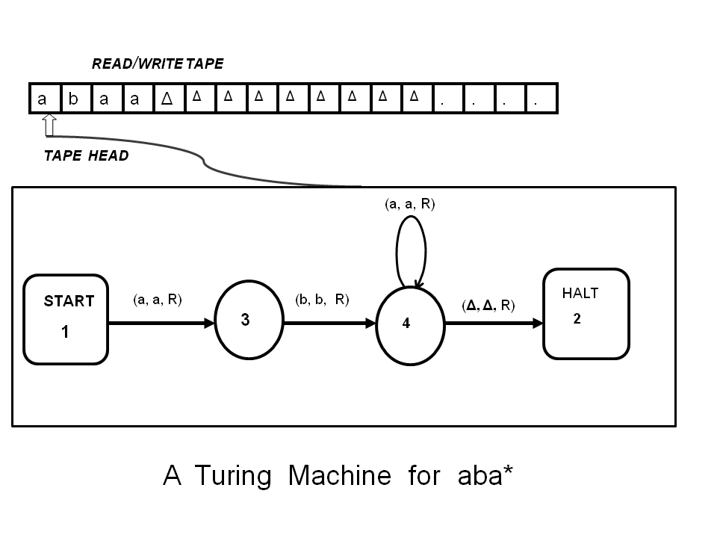
Advantages of Turing Machine.
Theoretical Foundation
Universality
Simplicity
Generalization
Theoretical Analysis

Slide 11
Conclusion
In conclusion, while Turing machines are not directly applied in the practical implementation of artificial intelligence (AI) systems, they serve as a crucial theoretical foundation and conceptual tool for understanding the capabilities and limitations of AI.

Slide 12
References
https://plato.stanford.edu/entries/turing-machine/#:~:text=Turing%20machines%2C%20first%20described%20by,the%20computing%20of%20real%20numbers.
https://brilliant.org/wiki/turing-machines/#:~:text=A%20Turing%20machine%20is%20an,that%20we%20simply%20cannot%20solve%3F
https://www.section.io/engineering-education/turing-test-in-ai/

Slide 13
THANK YOU

